Slide 1
Kickstarter Pilot Project
Executive Readout
Notes:
PM should kickoff the meeting and welcome everyone and be responsible for starting recording

Slide 2
Readout Agenda
Introductions (if needed)
Project Summary
Executive Summary & Objectives
Deliverables
Accomplishments
Summary
Outcomes
Recommendations & Next Steps
Notes:
PM can speak to the high level agenda, this can be modified to fit any extra steps desired or remove any unnecessary items

Slide 3
Project Summary
Notes:
Add Client Logo to the right panel

Slide 4
Executive Summary & Objectives
Where we started…
In order to understand where giving will be most successful, 3Cloud will provide a tool for donors to understand which projects will be successful in order to prioritize where/how to fund a project
Objectives/Goals: (What is the desired end-state of the project?)
A classification model that provides clear results on which projects are predicted to be successful.
A completed proof-of-concept model and dashboard
For Penn’s benefit, technical exposure and experience!
Notes:
Pull the executive summary from the SOW. In some cases, this may need to be trimmed down a bit if it is too wordy. List the objectives from the SOW, as well as any objectives added via CO. This should be a high-level overview of what this project was about.

Slide 5
Deliverables
Deliverable | Description
Single Classification Model | •Untuned XGBoost Model •Accuracy Metrics maximizing Precision with tradeoff •ROC Analysis and Threshold Tuning •Provides probability of prediction
PowerBI Dashboard | •Overview of model performance and the validation data set •Scoring Metrics and high level EDA
Data Prep & Modeling | •Prototype modeling dataset •Data profile •Machine Learning Pipelines
Data Definitions | •Data dictionary •Feature reference
Notes:
Recap on what Deliverables were spelled out from the SOW and any Change Orders

Slide 6
Project Accomplishments

Slide 7
Accomplishments Summary
Created a classification Model that performed well on validation data
A machine learning model to predict whether a project will be successful. (89% AUC at 94% Precision)
Automated data processing
Machine learning pipeline to process new data and feed to the model
Gained understanding around which features are important to the models
Data profiling
SHAP Values
Created documentation on the feature dictionary, data definitions, and future business use cases
Notes:
High-level summary of what was achieved relative to each objective spelled out earlier. This shouldn’t be extremely detailed, just bullet points on what was accomplished by 3Cloud to achieve each objective from the SOW.
Tech Lead should speak to this slide and most of the Outcome slides

Slide 8
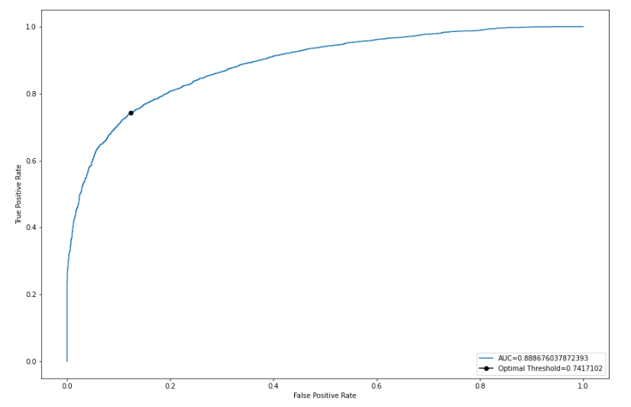
Threshold Tuning
Notes:
High-level summary of what was achieved relative to each objective spelled out earlier. This shouldn’t be extremely detailed, just bullet points on what was accomplished by 3Cloud to achieve each objective from the SOW.
Tech Lead should speak to this slide and most of the Outcome slides

Slide 9
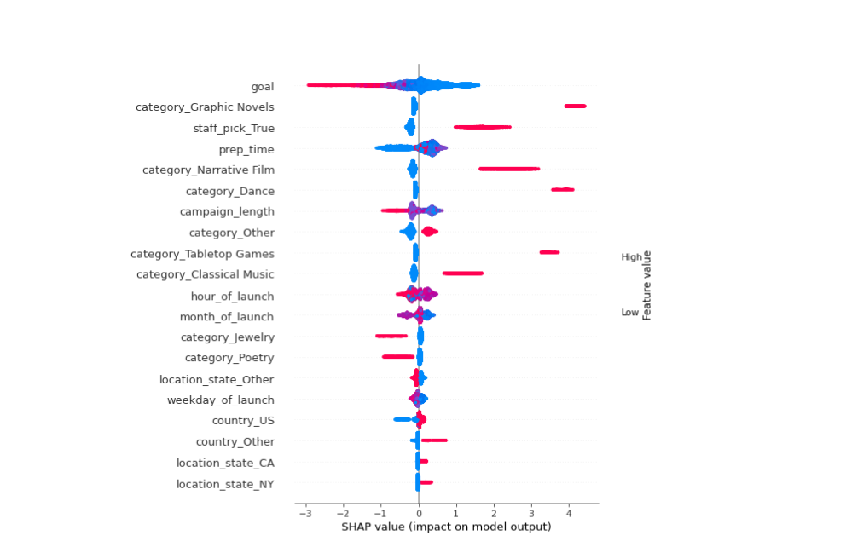
SHAP
Notes:
High-level summary of what was achieved relative to each objective spelled out earlier. This shouldn’t be extremely detailed, just bullet points on what was accomplished by 3Cloud to achieve each objective from the SOW.
Tech Lead should speak to this slide and most of the Outcome slides

Slide 10
Recommendations / Next Steps

Slide 11

Immediate Recommendations
Begin testing model with using live data, using causal inference to determine the effectiveness of the model
Add filtering to an individual project to determine the success
This will begin to determine what projects to give to
Build a regression model to predict the amount raised for the campaign to determine how successful campaigns will be
This will begin the process of determining how much to give

Slide 12
Recommendations for the backlog
Add experiment observability
Add SHAP Values to Power BI Dashboard
More feature engineering of the data provided
Squeeze every bit of predictive power out of what is available
Integrate MLFlow
To minimize business risk through superior versioning of experimental details
Hyperparameter Tuning
Squeeze further predictive power from the model by tuning it's parameters
AutoML
Ensure that the selected algorithm is the most predictive

Slide 13
Business Use Cases
1
Individual Project Giving
Low Effort
Solution: Add a filtering visual to the Power BI that allows you to search a project by name/id and gives you probability of success.
Value: Ability to begin investing in projects likely to succeed
2
Portfolio Optimization
High Effort
Value
Solution: Model optimizing both which campaigns will be successful, and also the amount to give to ensure the campaign is successful
Value: Optimize your portfolio to different projects to maximize impact both in terms of campaigns funded and amount given
3
Automate Campaign giving
Medium Effort
Solution: A model could be built on top of the portfolio model to automate giving to selected categories that will be successful. It can automatically give based on project mission/campaign goals with some NLP
Value: Passive management of giving

Slide 14
Thank you!
We look forward to working with you again soon!

